Slide 1

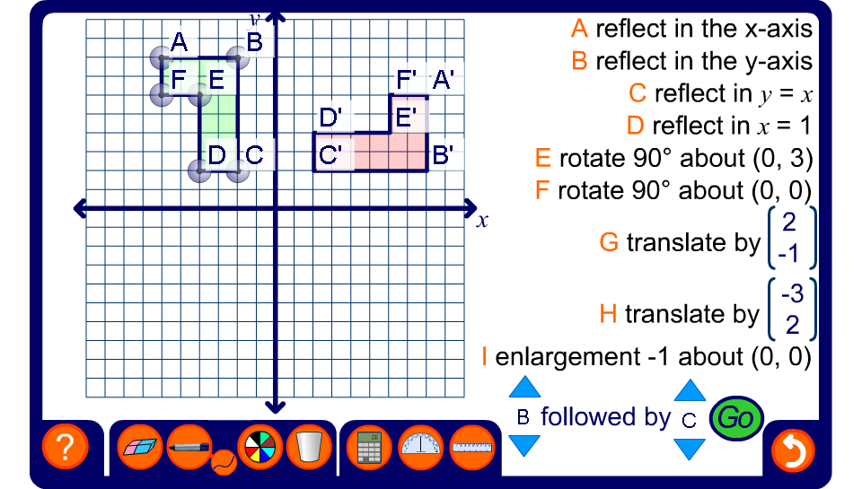


Combining transformations
Notes:
Select two transformations to be performed on shape L. Ask a volunteer to use the pen tool to draw the position of L after the given pair of transformations before revealing the solution.
Investigate which pairs of transformations are commutative.
Investigate which pairs of transformations are equivalent to a single transformation.

